Slide 1
openEuler 支持 AMD SEV-SNP 介绍
Wenkuan.Wang@amd.com

Slide 2
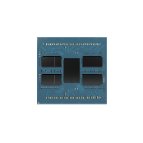
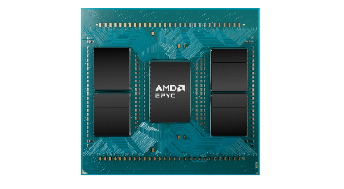
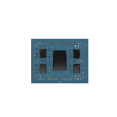
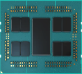

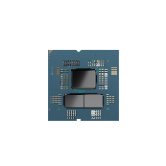
AMD EPYC™ Processors Five generations of on time technology innovation
5th Gen AMD EPYC™
4th Gen AMD EPYC™
3rd Gen AMD EPYC™
2nd Gen
AMD EPYC™
9004
SP5
1st Gen
AMD EPYC™
8004
SP6
9005
SP5
7001
SP3
7002
SP3
7003
SP3
4004
AM5
Future products
All roadmaps are subject to change.
Notes:
We have executed flawlessly to our commitments with over 5 generations of on-time execution – with each generation delivering improved performance and energy efficiency.
With each generation, more and more customers adopted EPYC because of our leading performance, energy efficiency, and total cost of ownership....
And over the course of this roadmap…. Now including Turin at 192c…. We have delivered 6X core counts and over 11X the performance, while also delivering double digit Instructions per Cycle (IPC) gains for every generation...

Slide 3

AMD Infinity Guard Journey Multiple Generations of Security Leadership in Confidential Computing
Secure Boot
SME
SEV
New in 5th Gen AMD EPYC™ CPUs
SEV-ES
SEV-SNP
Trusted I/O
2017
2019
2021
2023
2024
AMD launches Secure Encrypted Virtualization
SEV Encrypted State adds register encryption
SEV Secure Nested Pages adds malicious hypervisor protection
AMD publishes
SEV-SNP source code
AMD extends the trust boundary to include external devices
Trusted Boundaries
Storage
SmartNICs
Trusted IO
CPU
Trusted IO
Trusted IO
Accelerators
AMD Infinity Guard features vary by EPYC™ Processor series and/or generations. Infinity Guard security features must be enabled by server OEMs and/or Cloud Service Providers to operate. Check with your OEM or provider to confirm support of these features. Learn more about Infinity Guard at https://www.amd.com/en/technologies/infinity-guard. GD-183A
Notes:
AMD’s Confidential Computing Journey with Infinity Guard started in 2017 with the first generation EPYC CPUs. At this time we introduced Secure Memory Encryption (SME) – which provides full main memory encryption with a single key, owned and managed by the embedded secure processor. That capability is available on all subsequent generations. We also introduced Secure Encrypted Virtualization (SEV) which encrypts the main memory space of each VM with a unique key – owned and managed by Secure Processor embedded in the SOC – which owns and manages all the keys.
Since then, AMD continued investing and evolving Infinity Guard adding features for increased protection
In 2023, AMD published Genoa SEV-SNP source code as part of ‘Assurance by Transparency’ initiative
Security is a key customer buying criteria and becoming even more so in the age of AI as the need to protect data moves beyond the CPU to external devices like GPU accelerators, SmartNICs and storage. With 5th gen EPYC, we have now added Trusted I/O to extend the trust boundary to these external devices, an increasingly critical capability with a lot of data being moved back and forth between the CPU and accelerators, as well as across the network.
You will see us start to enable more solutions in the ecosystem with this new and innovative feature.
******************************************************************************************************************************************************************************************************************************************
Note: AMD is actively involved with the opensource community and regularly up-streams patches to the Linux community. Our in-progress projects are posted on GitHub for customers, partners and interested parties to evaluate and provide feedback. AMDESE · GitHub
******************************************************************************************************************************************************************************************************************************************************

Slide 4
SEV-SNP
https://lore.kernel.org/lkml/20240311151909.GAZe8g7SqDKRcP4XrO@fat_crate.local/
Add the x86 part of the SEV-SNP host support. This will allow the
kernel to be used as a KVM hypervisor capable of running SNP (Secure
Nested Paging) guests. Roughly speaking, SEV-SNP is the ultimate goal
of the AMD confidential computing side, providing the most
comprehensive confidential computing environment up to date.
This is the x86 part and there is a KVM part which did not get ready
in time for the merge window so latter will be forthcoming in the next
cycle.

Slide 5
SEV-SNP
https://lore.kernel.org/lkml/20240421180122.1650812-1-michael.roth@amd.com/
"This part of the Secure Encrypted Paging (SEV-SNP) series focuses on the changes required to add KVM support for SEV-SNP. This series builds upon SEV-SNP guest support, which is now in mainline, and and SEV-SNP host initialization support, which is now in linux-next.
While series provides the basic building blocks to support booting the SEV-SNP VMs, it does not cover all the security enhancement introduced by the SEV-SNP such as interrupt protection, which will added in the future.
With SNP, when pages are marked as guest-owned in the RMP table, they are assigned to a specific guest/ASID, as well as a specific GFN with in the guest. Any attempts to map it in the RMP table to a different guest/ASID, or a different GFN within a guest/ASID, will result in an RMP nested page fault."

Slide 6
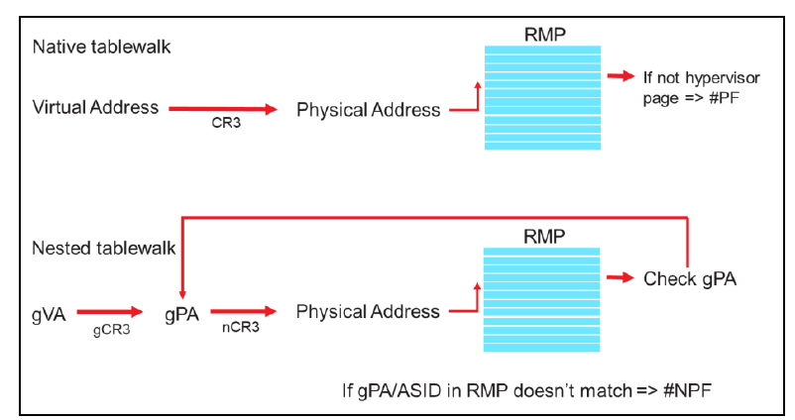
SEV-SNP

Slide 7
SNP Patches
OVMF/EDK2 (Guest support stable202405)
Kernel (Guest Support May 2022 linux-5.19)
Kernel (Host Support June 2024 linux-6.11)
QEMU (Host Support 9.1)

Slide 8
Kernel (Guest Support May 2022 linux-5.19)
https://lore.kernel.org/lkml/YotXilVhT2BZHZ5R@zn.tnic/
AMD SEV-SNP support
Add to confidential guests the necessary memory integrity protection
against malicious hypervisor-based attacks like data replay, memory
remapping and others, thus achieving a stronger isolation from the
hypervisor.
At the core of the functionality is a new structure called a reverse
map table (RMP) with which the guest has a say in which pages get
assigned to it and gets notified when a page which it owns, gets
accessed/modified under the covers so that the guest can take an
appropriate action.
In addition, add support for the whole machinery needed to launch a SNP
guest, details of which is properly explained in each patch.
And last but not least, the series refactors and improves parts of the
previous SEV support so that the new code is accomodated properly and
not just bolted on.

Slide 9
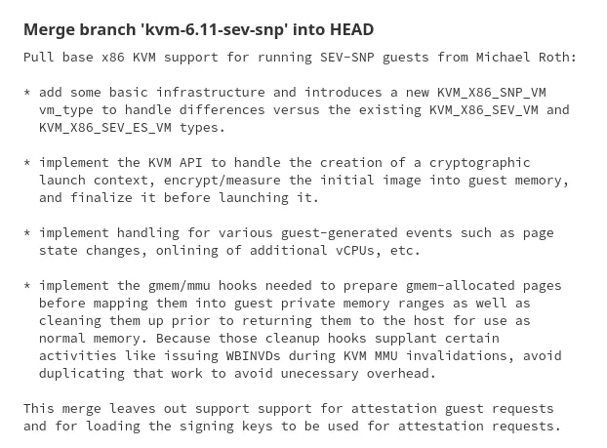
Kernel (Host Support June 2024 linux-6.11)
https://git.kernel.org/pub/scm/virt/kvm/kvm.git/commit/?h=next&id=ab978c62e72d6b2d4184

Slide 10
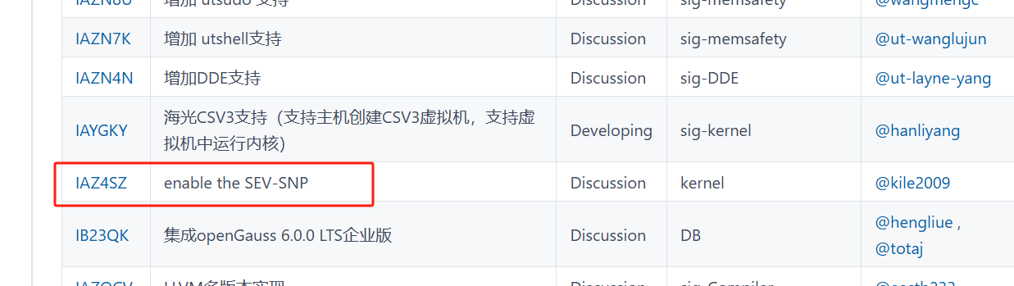
openEuler-24.03-LTS-SP1
https://gitee.com/openeuler/release-management/blob/master/openEuler-24.03-LTS-SP1/release-plan.md

